Slide 1
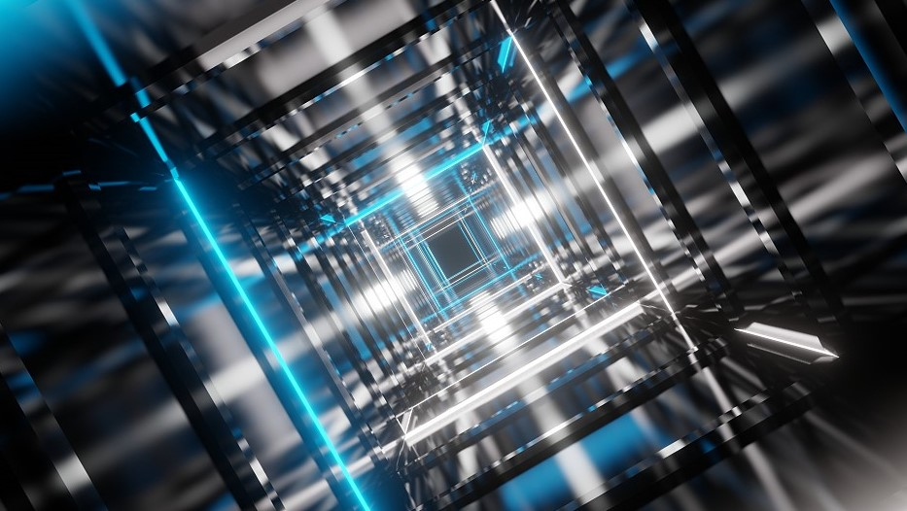

AI
Biological Blueprint of AI
Reporter: Tanzeela Fatima

Slide 2
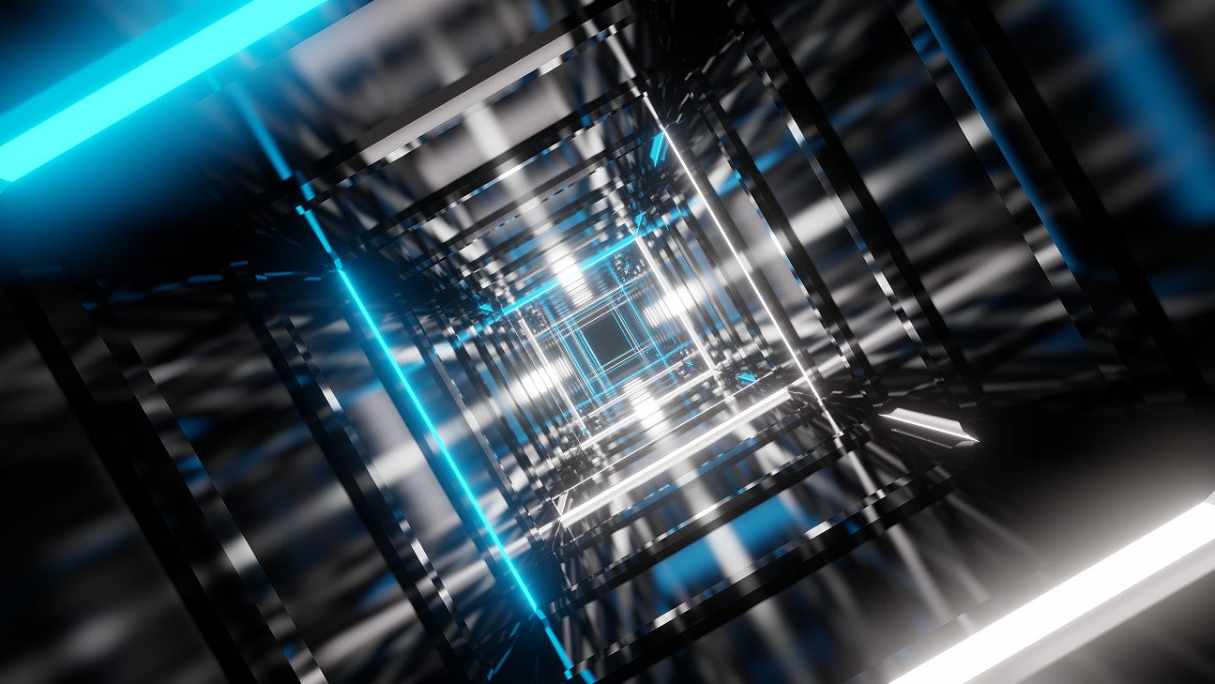
?
To Build Artifical ntelligence,
we myst first understand
Natural intellegence
It’s in ants ,brirds even
plants

Slide 3
01
Rebel’ Origin
Zeeshan Usmanu’s journey

Slide 4
Unconventional Path to AI
Self Study
Mentorship
!998
Master
Questions
Through books
Studying behaviour
Learn from others
Kicked out of his first AI class for asking too many questions
Focus to buy books and leran on his own without the internet
Specialized in Swarm Intelligence,studying animal behaviours
Learned from pioneer like John Holland,father of genetic algorithms

Slide 5
02
What is intelligence
Beyond the human brains

Slide 6
Are plants inteligence ?

Slide 7
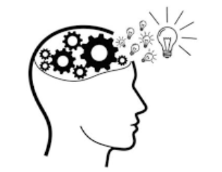
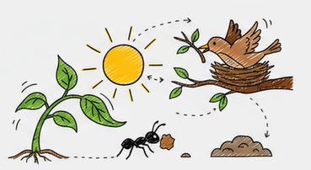
Artifical Intelligence
Intelligence
A broader view: Intelligence is the ability to achieve
goals in a wide range of environments.

Slide 8

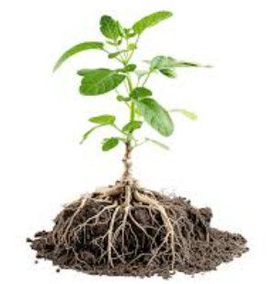
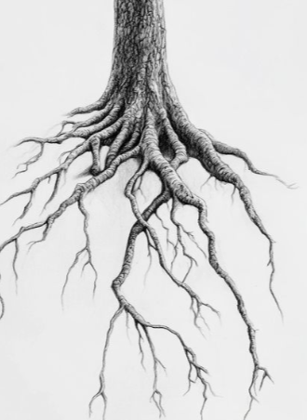

Evidence of Plant Intelligence
TOPIC

Slide 9
03
Nature’s Secret Blueprint
From Biology to AI

Slide 10
Swarm Intelligence
he collective behavior of decentralized systems, where simple actions lead to intelligent group
behavior.

Slide 11



The Bio-Inspired Process
Obsereve
Researchers study natural
systems like ant colonies,
bees. and spiders.
Replicate
Process
They translate this
biological logic into
computer algorithms.
Identify
They pinpoint efficient
behaviors, like finding the
best path.

Slide 12
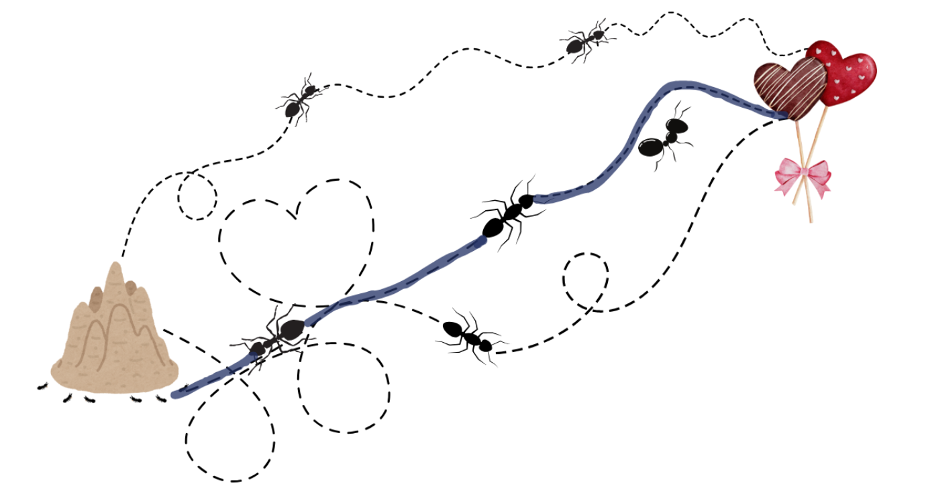

Slide 13


Slide 14

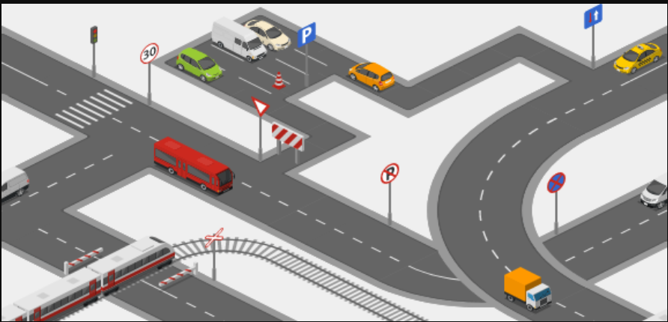

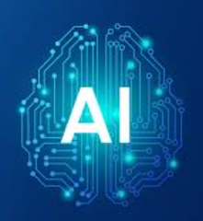
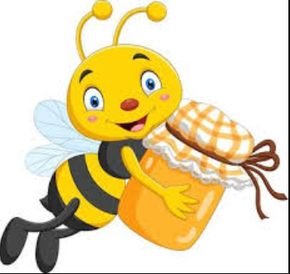

Slide 15
04
Ant Hills to Lgorithms
Real world application

Slide 16
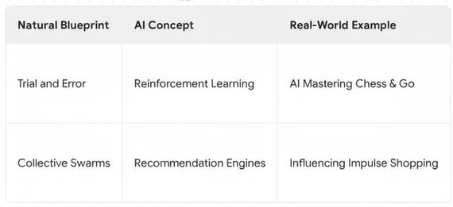
Artifical Intelligence
Topic
Topic
Topic
Topic
Presentations are communication tools.
Presentations are communication tools.
Presentations are communication tools.
Presentations are communication tools.
1
2
3
4

Slide 17
I used Swarm Intelligence to build recommendation engines for retailers like Walmart to imorive impulse shopping

Slide 18
Why this MAtters To You
05
The future of work

Slide 19
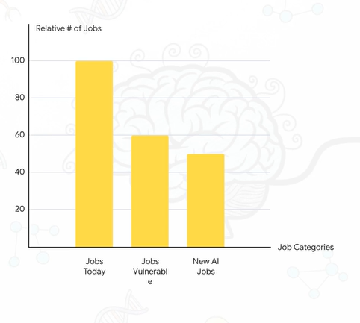
Artifical Inteligence
The world of work is
transforming. Many jobs are
vulnerable, while new jobs
are emerging.

Slide 20
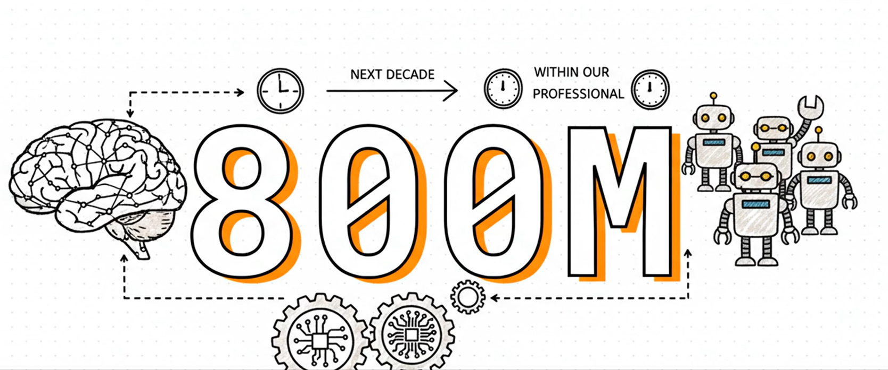
Why this MAtters To You
05
The future of work

Slide 21
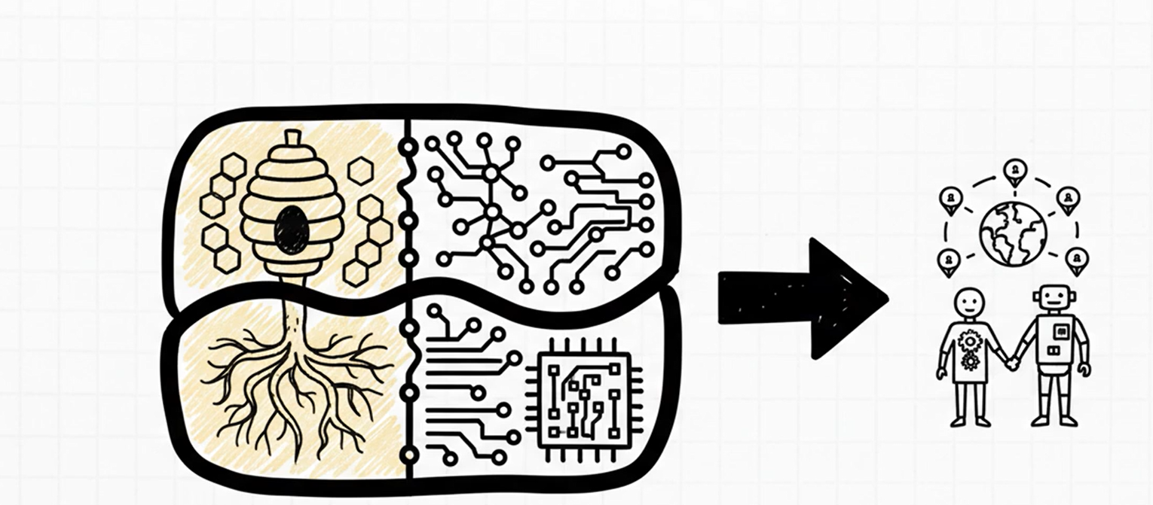
Why this MAtters To You
05
The future of work

Slide 22
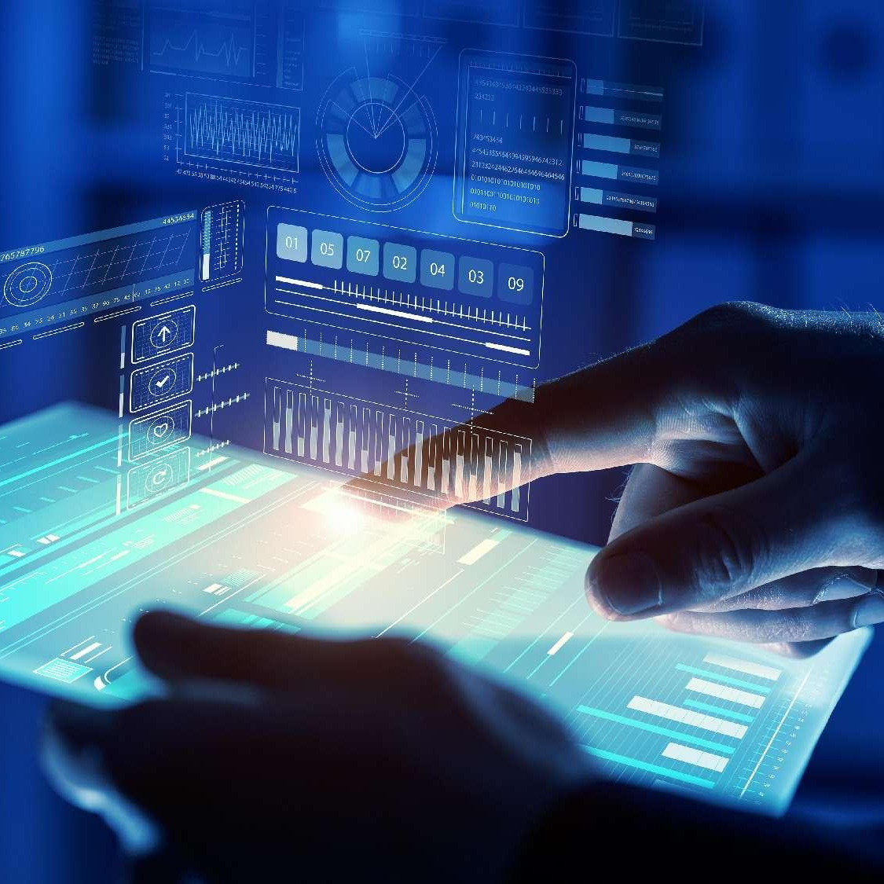

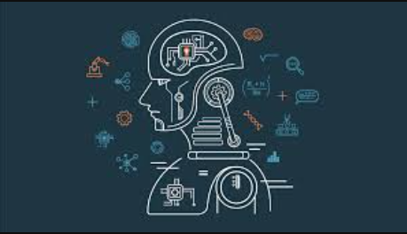
YOUR TITLE HERE
AI Learns
If AI learns from nature what can it teach us
about ourselves?

Slide 23
AI
03
Biological Blueprint of AI
THANK YOU
Reporter: Tanzeela Fatima

